Slide 1




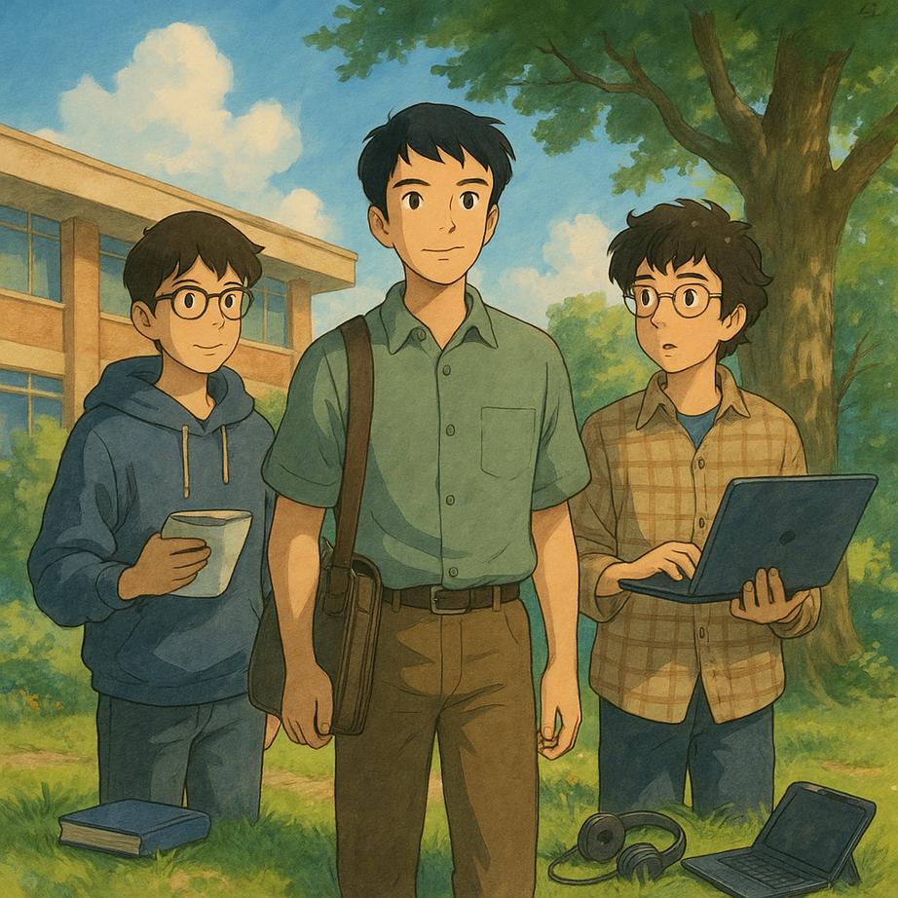

CloudCraft 2025
Civic Tech: Build for Better Governance
ECOEARTH
An initiative towards a sustainable INDIA
Harshit
(DevOps)
NIKHIL
(DevOps)
Rehan
(Backend)

Slide 2

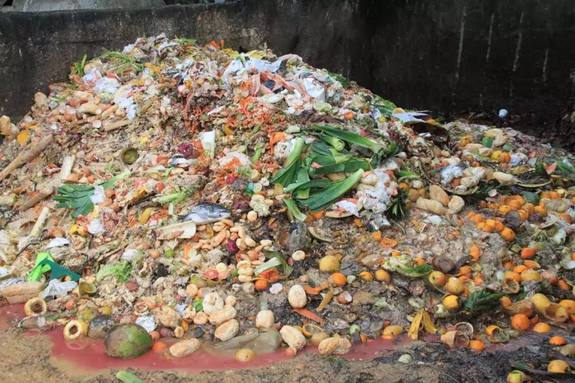
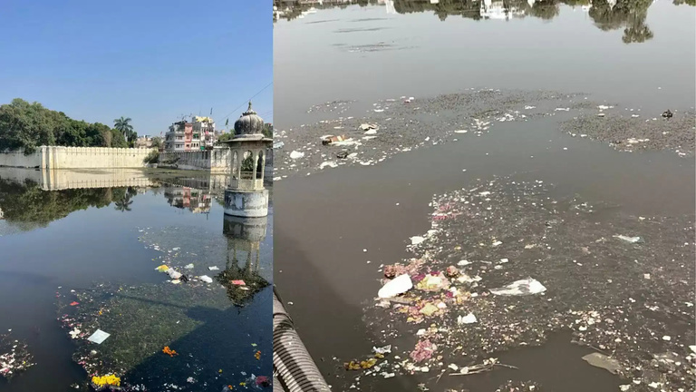

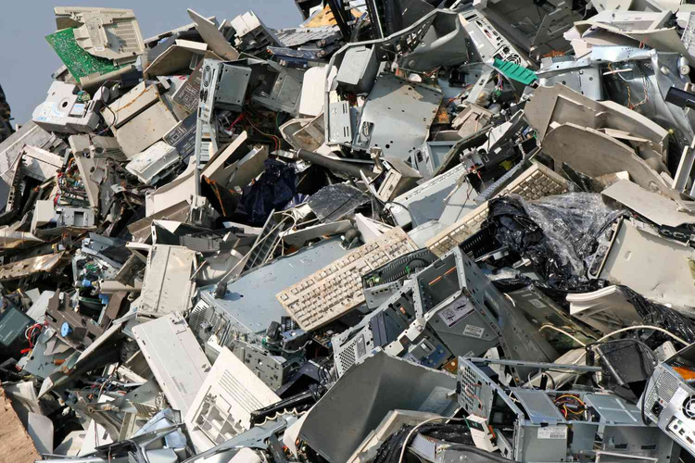
Problem Statement
Many people still suffer from hunger due to poor coordination and ineffective food distribution.
NGOs struggle to organize and promote community events effectively.
FOOD WASTE
DIRTY LAKE'S
Lack of awareness about government schemes and projects prevents people from receiving available benefits.
E-waste is poorly managed due to low awareness and lack of proper disposal channels.
INCOMPLETE GOVT. PROJECT
E-WASTE PROBLEM

Slide 3
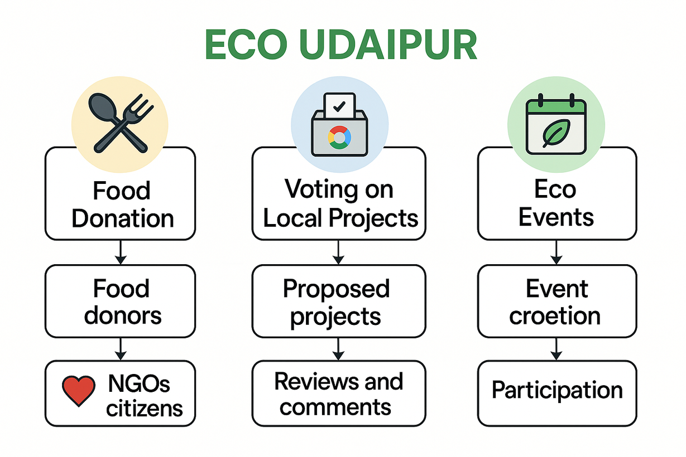









PROPOSED SOLUTION
TECH STACK
Website
Front-end
Back-end
Database
Webserver
Container
Nginx
Docker
Cloud &
Other
Website: www.ecoearth.site
Compute Engine
Domain Name

Slide 4
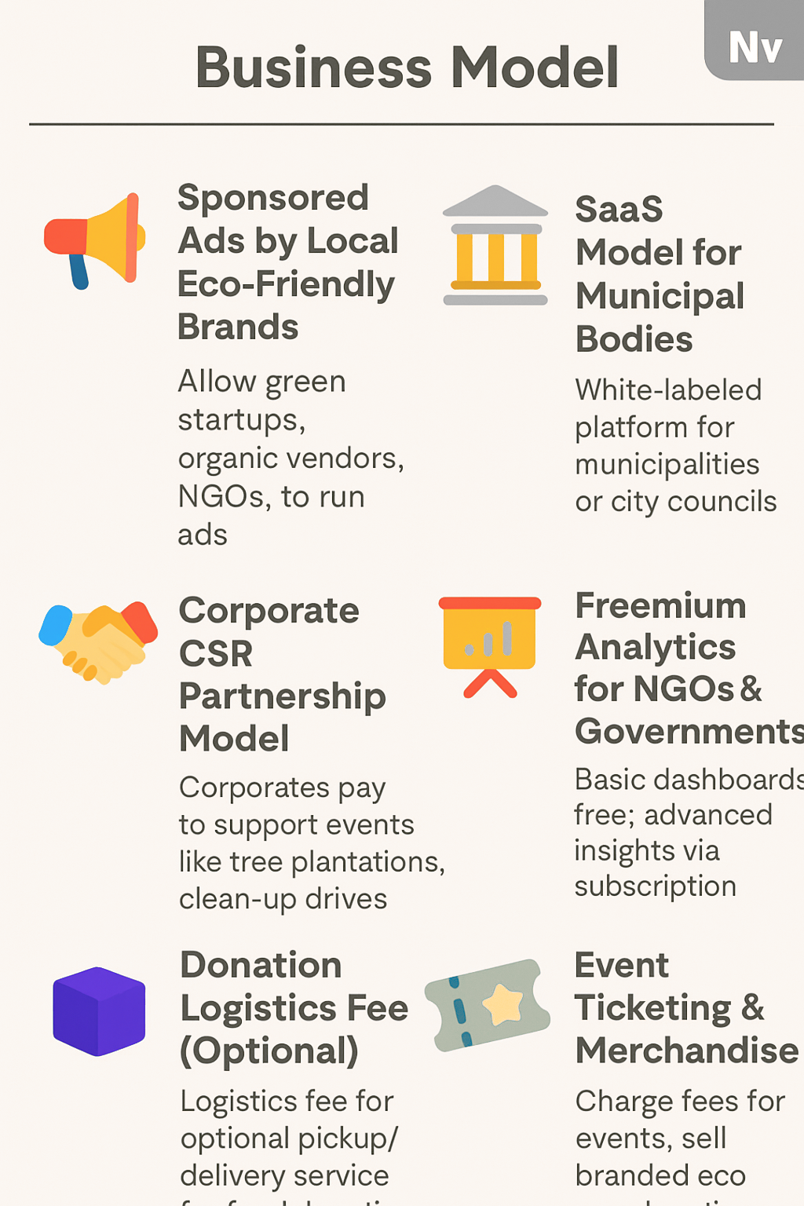
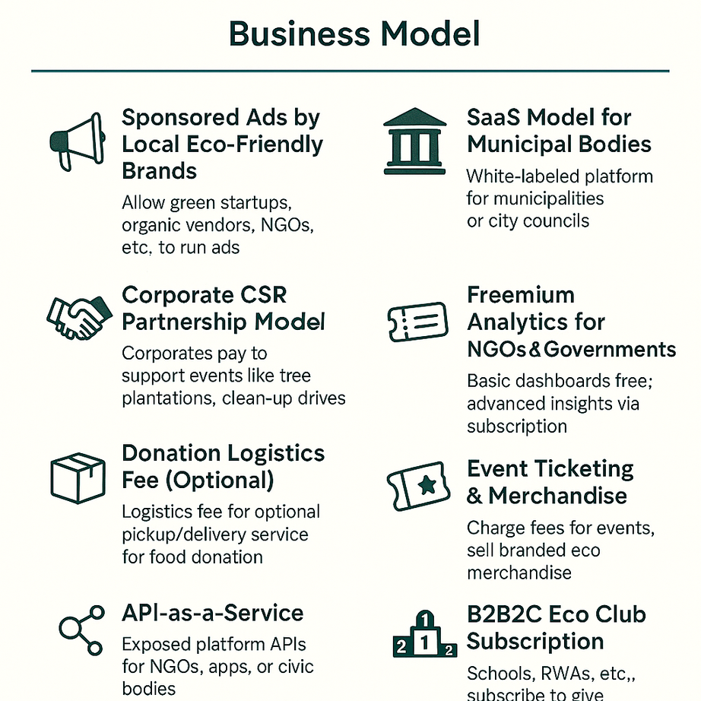

Slide 5

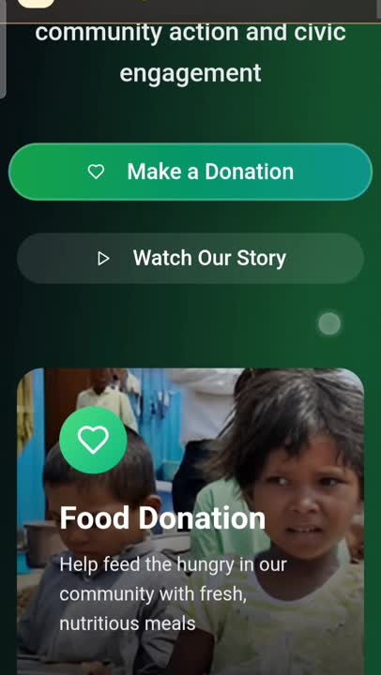
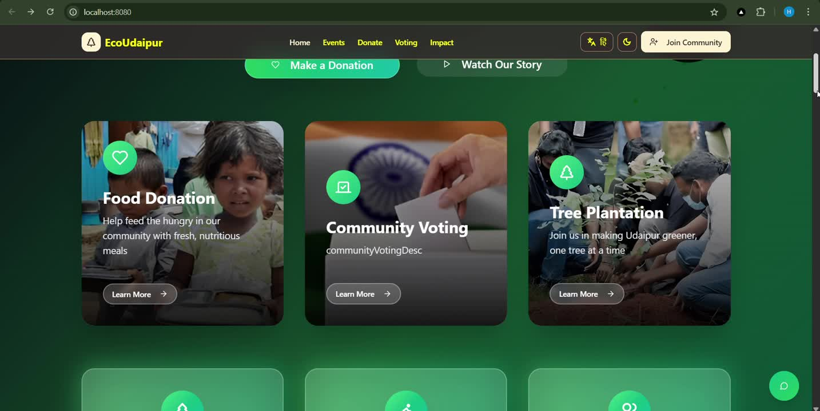

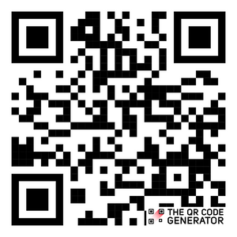
CIVIC GOVERNANCE : Made Smarter with Our WebApp
ECO EARTH
RESEARCH & REFRENCE
WEBSITE :
Link1: Hunger
Link 2: E-waste
Link3 Incomplete Govt project
THANK YOU

